Slide 1
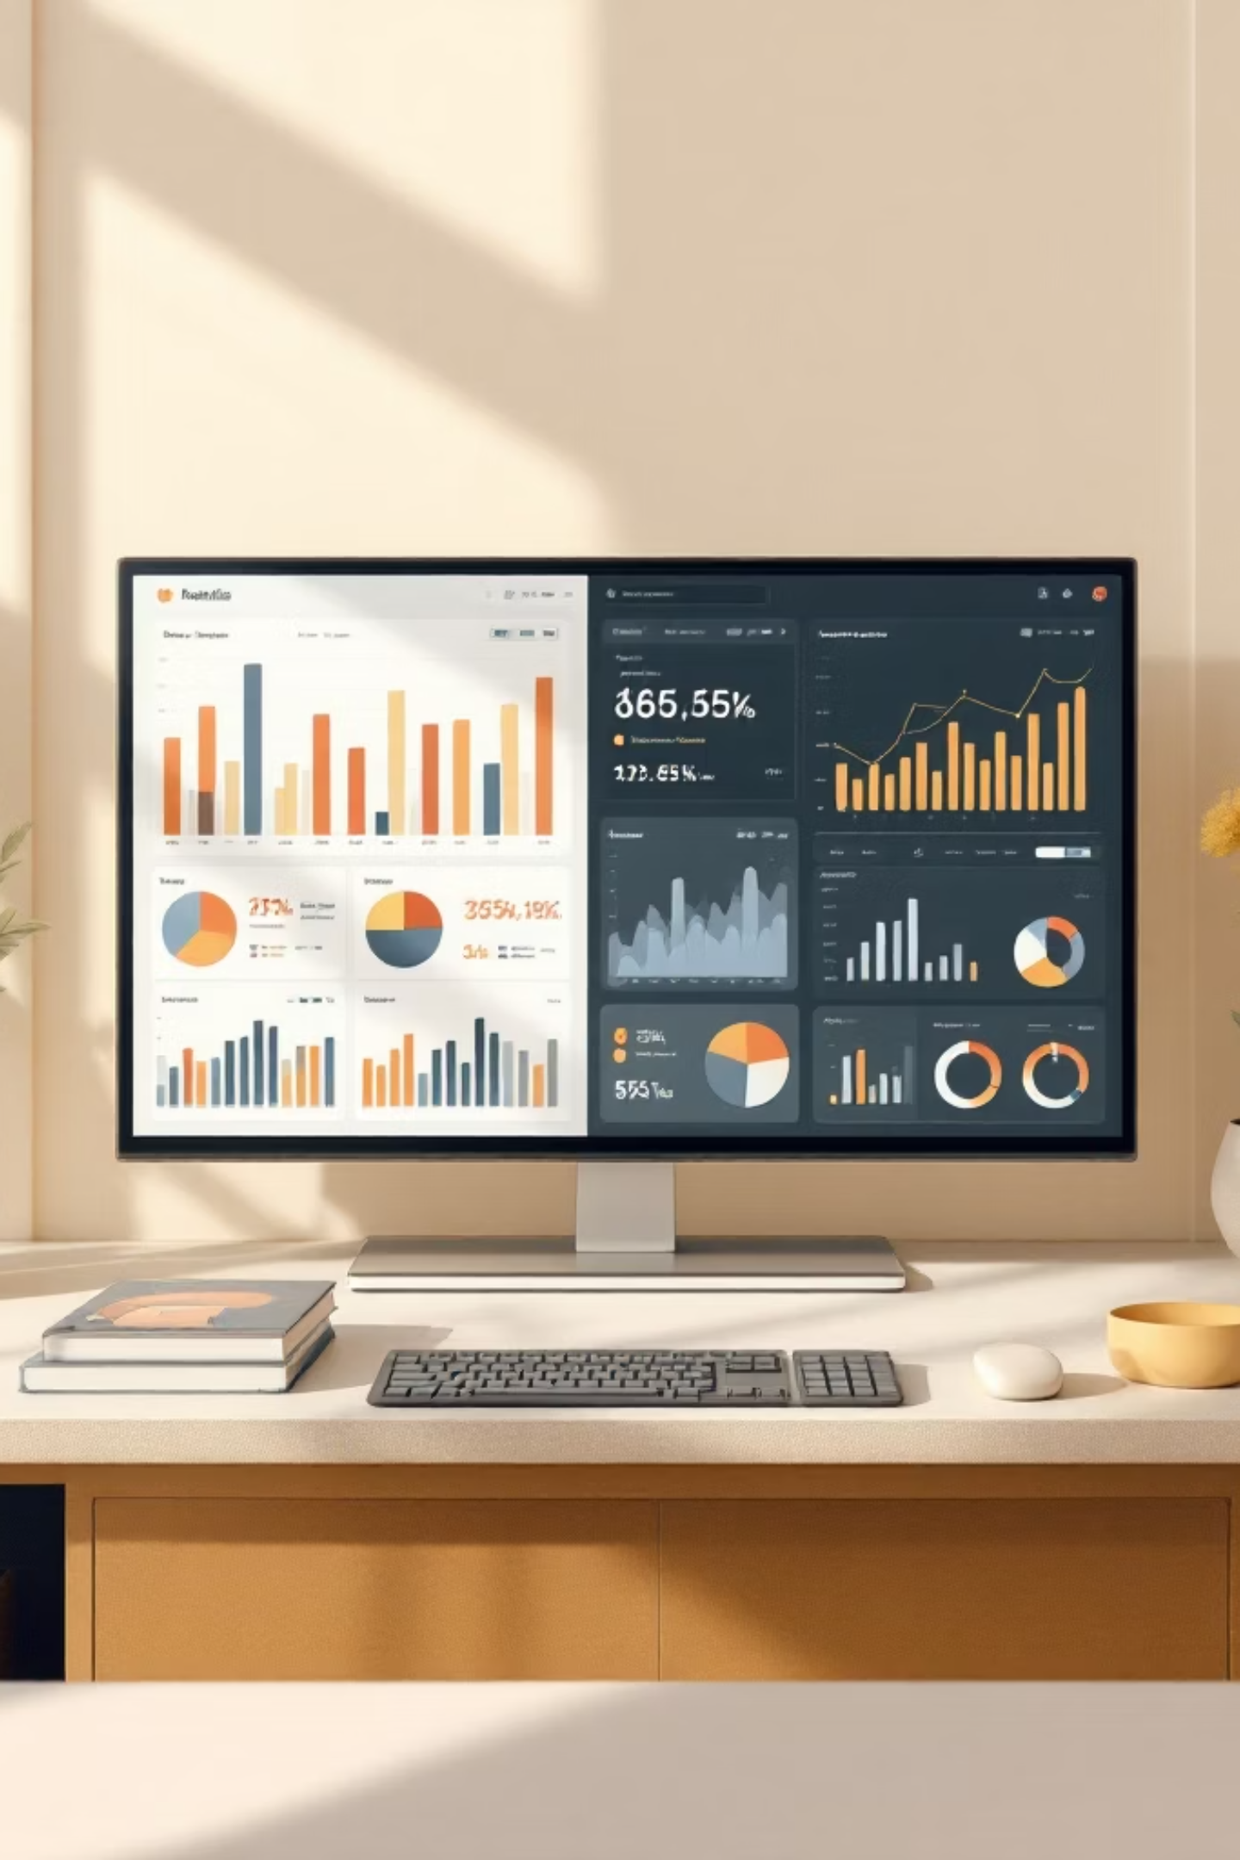
Customer Shopping Behavior Analysis
3,900 transactions analyzed across demographics, purchases, and shopping behavior

Slide 2
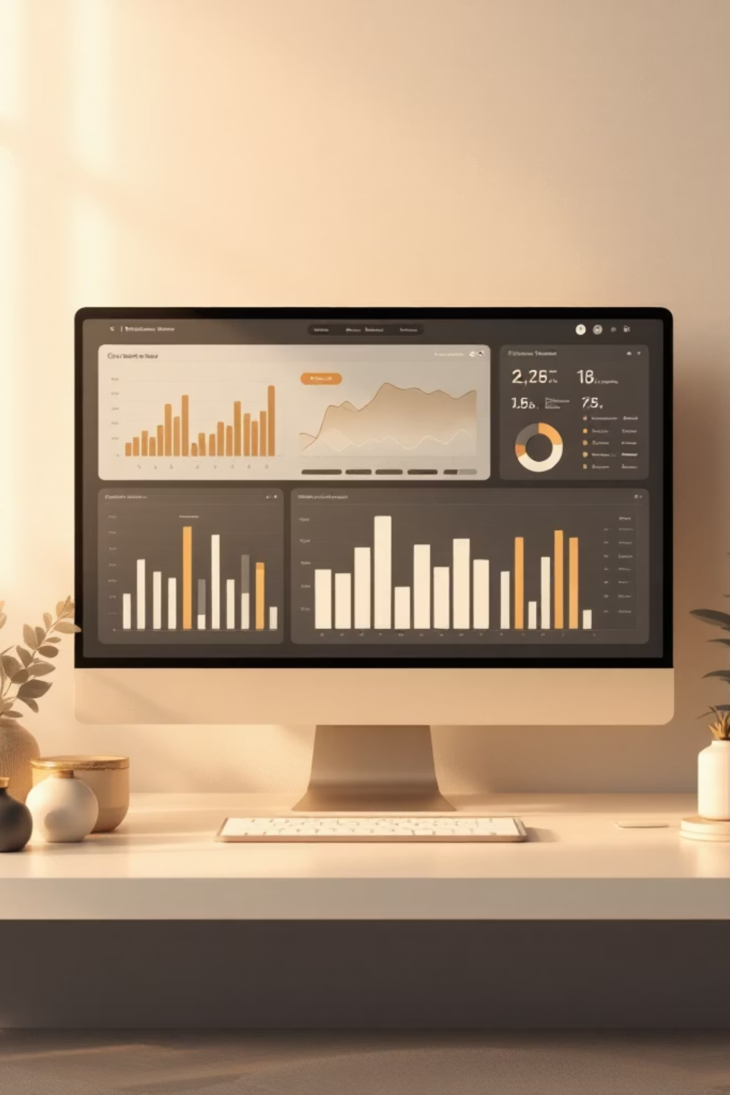
Dataset Overview
3,900
18
37
Transactions
Features
Missing Values
Rows in dataset
Columns analyzed
In Review Rating

Slide 3
Data Preparation Process
01
02
Data Loading
Initial Exploration
Imported using pandas
df.info() and .describe()
03
04
Missing Data Handling
Standardization
Imputed median by category
Snake case columns
05
06
Feature Engineering
Database Integration
Age groups, frequency days
Loaded to PostgreSQL

Slide 4
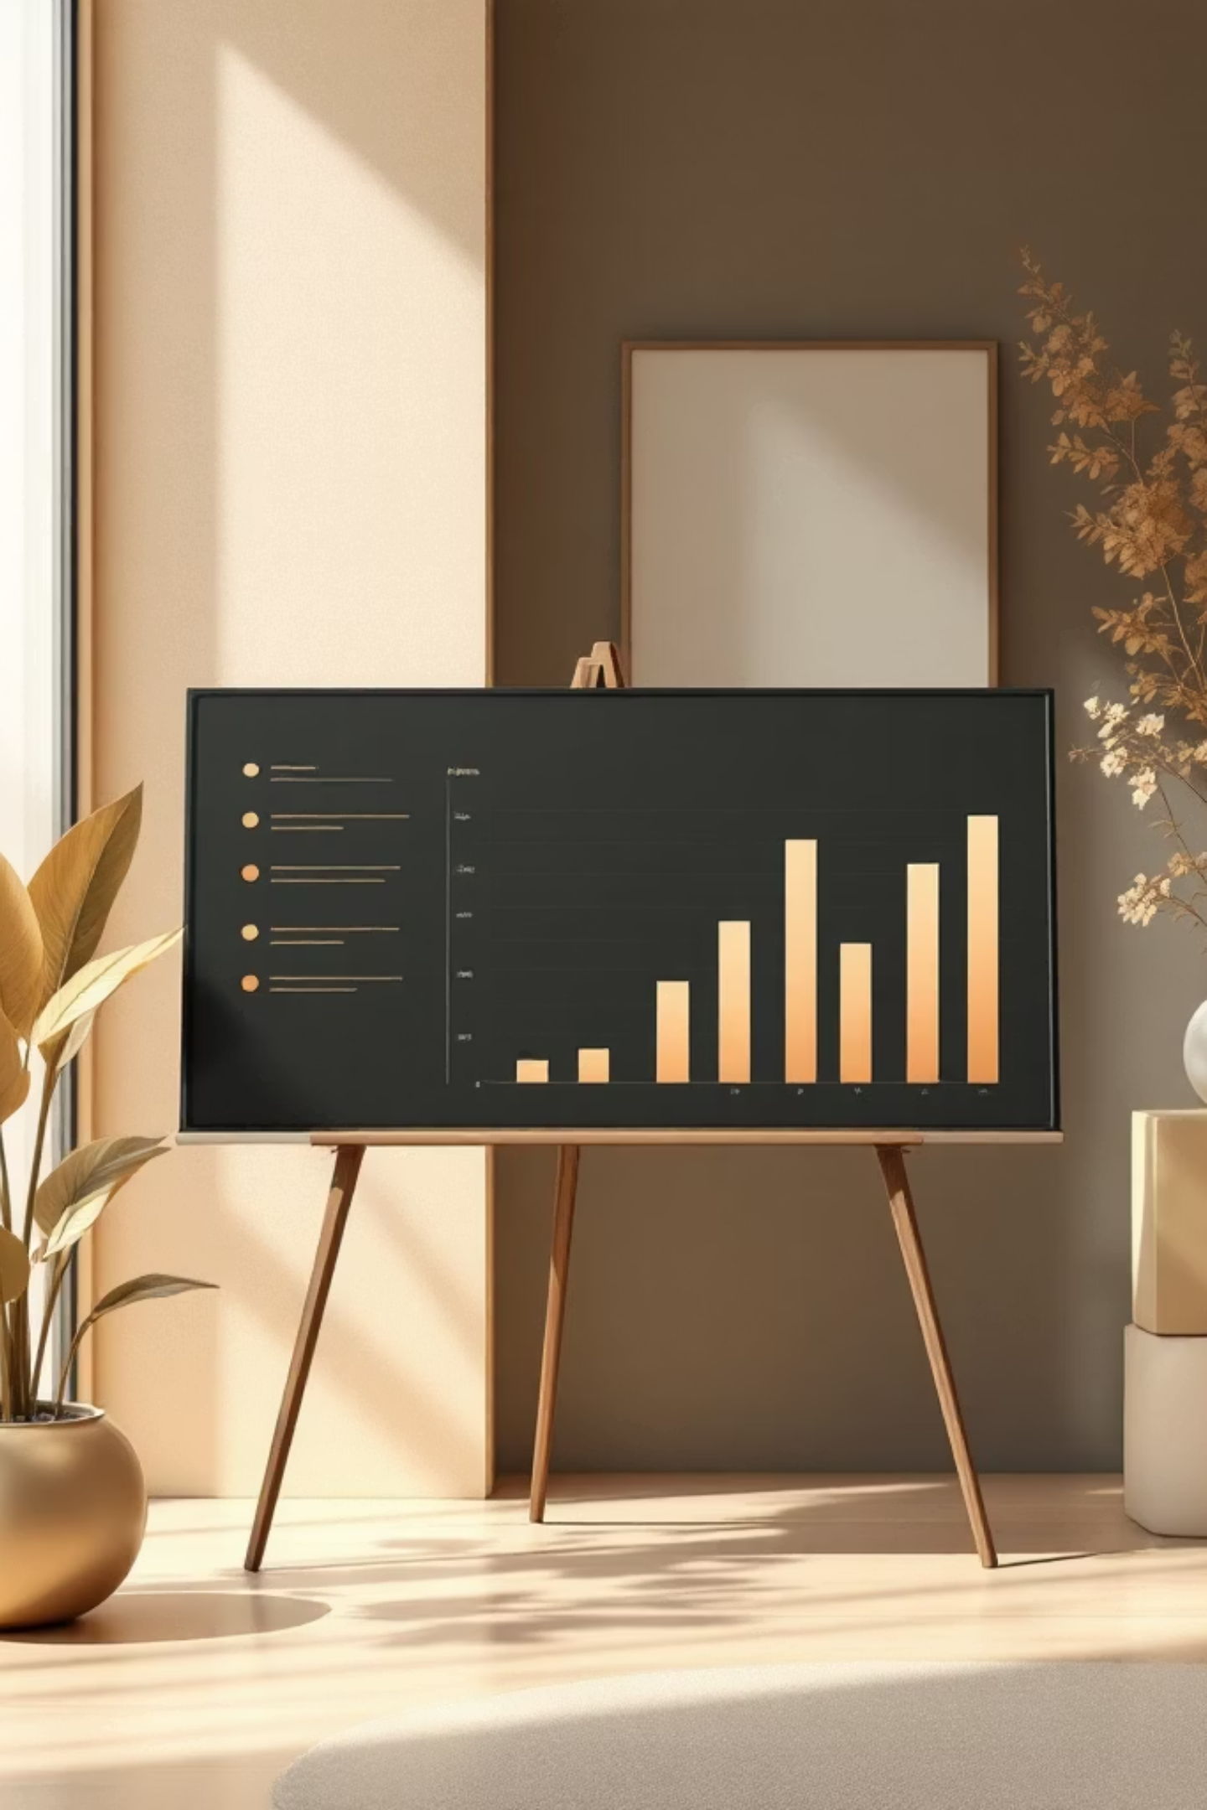
SQL Analysis: Revenue Insights
Revenue by Gender
High-Spending Discount Users
Compared total revenue generated by male vs. female customers
Identified customers who used discounts but spent above average purchase amount

Slide 5



SQL Analysis: Product Performance
Top 5 Products by Rating
Discount-Dependent Products
Top 3 Products per Category
Products with highest average review ratings
5 products with highest percentage of discounted purchases
Most purchased products within each category

Slide 6



SQL Analysis: Customer Segmentation
Shipping Type Comparison
Subscribers vs. Non-Subscribers
Repeat Buyers & Subscriptions
Standard vs. Express shipping purchase amounts
Average spend and total revenue comparison
Customers with >5 purchases and subscription likelihood

Slide 7
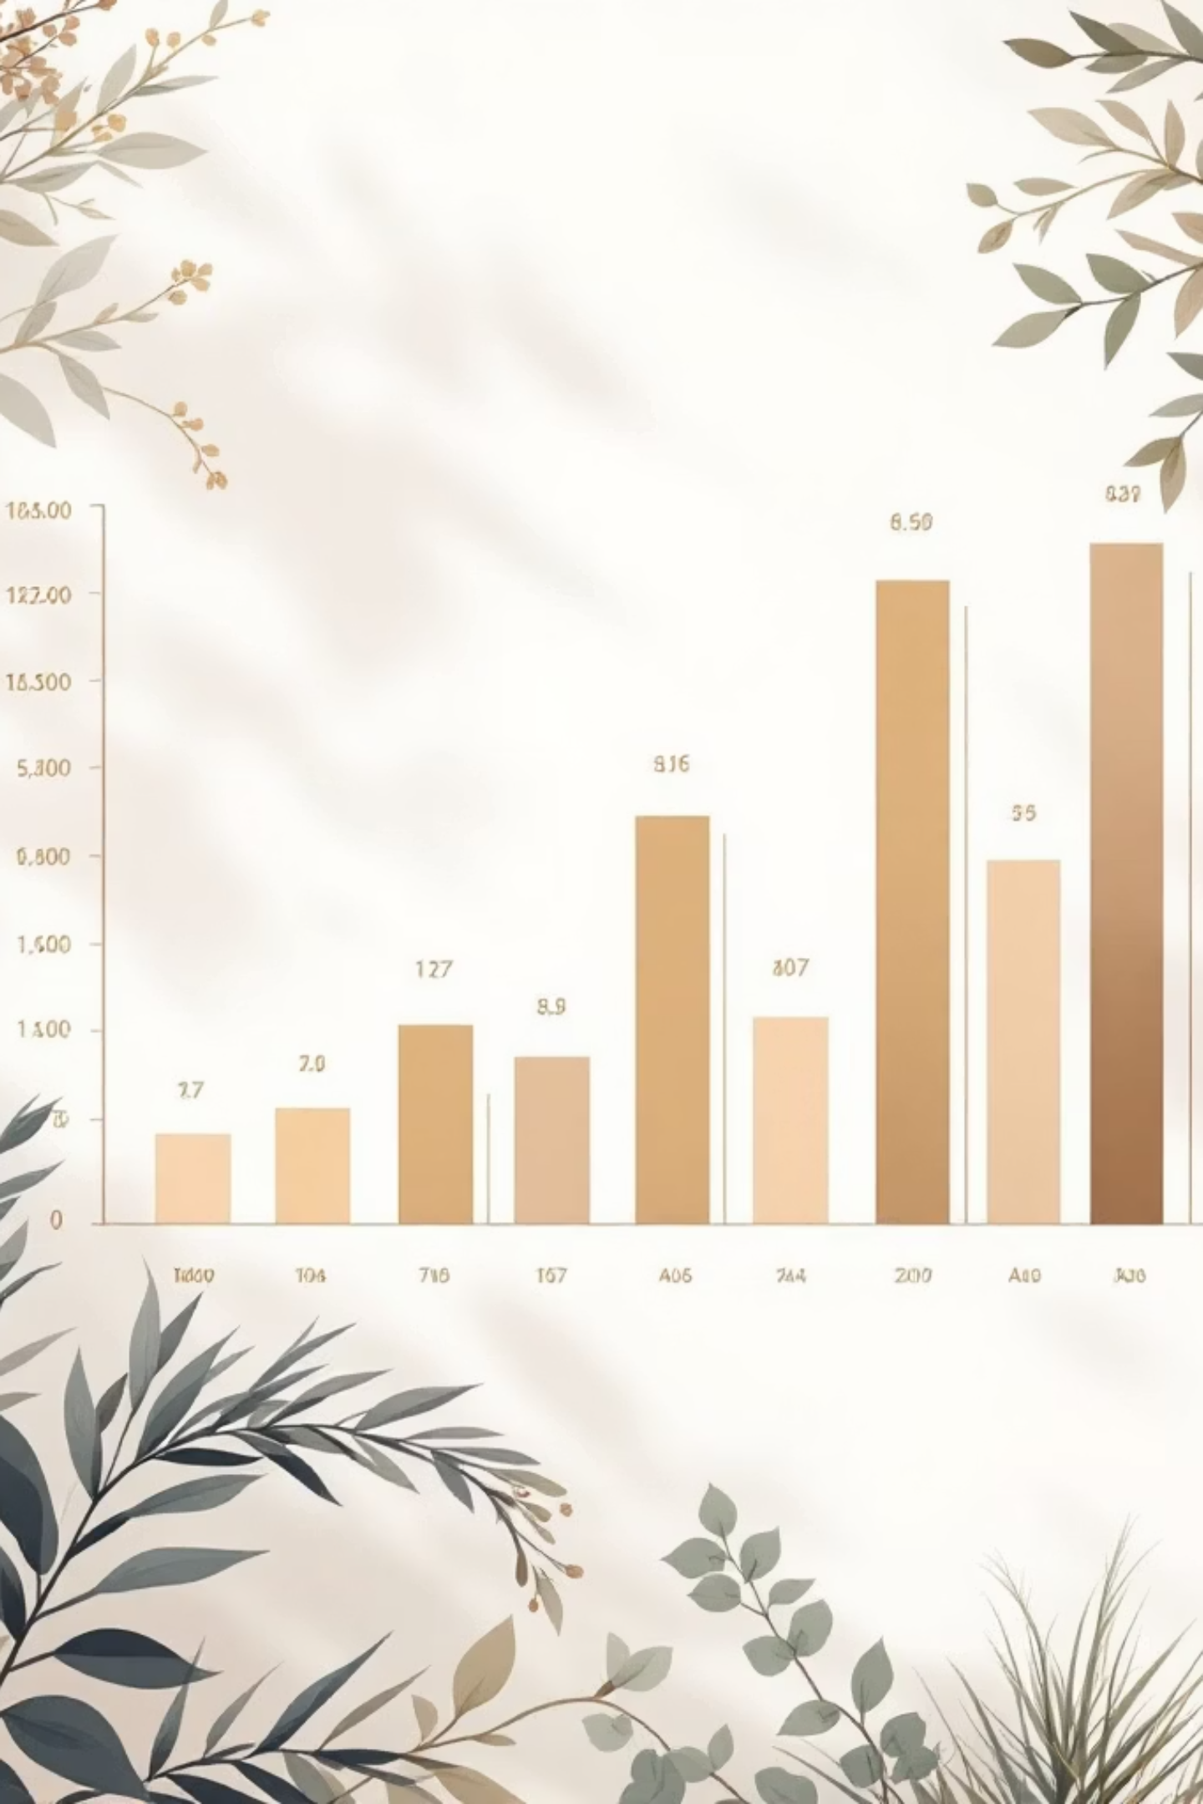
SQL Analysis: Age & Revenue
Revenue by Age Group
Calculated total revenue contribution of each age group

Slide 8
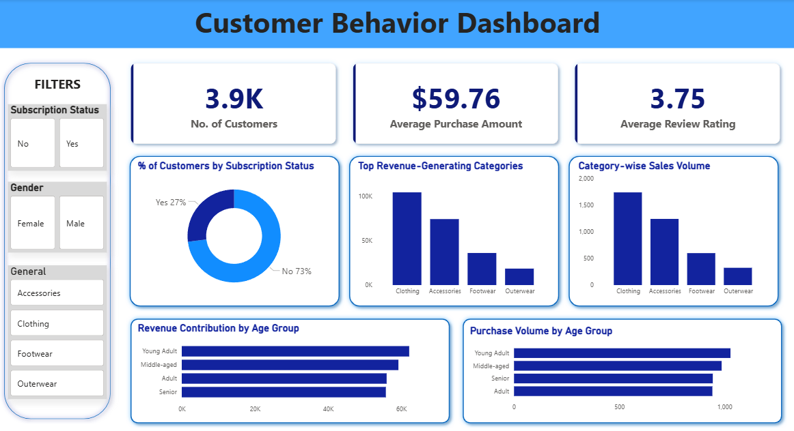
Power BI Dashboard
Interactive dashboard built to present insights visually

Slide 9
Business Recommendations
1
2
3
Boost Subscriptions
Customer Loyalty Programs
Review Discount Policy
Promote exclusive benefits for subscribers
Reward repeat buyers to move into "Loyal" segment
Balance sales boosts with margin control
4
5
Product Positioning
Targeted Marketing
Highlight top-rated and best-selling products in campaigns
Focus on high-revenue age groups and express-shipping users

Slide 10

Key Takeaways
3,900 Transactions
18 Features
Comprehensive dataset analyzed
Demographics, purchases, behavior
Actionable Insights
Strategic business recommendations

